Slide 1

Who can do what?
IMP 5.4
UNESCO
Intangible Cultural Heritage Section

Slide 2
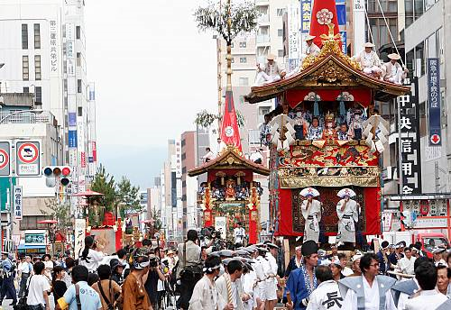
The Yamahoko float ceremony, Kyoto Gion festival, Japan
The float procession through the streets of Kyoto
(c) 2007 Inoue Shigeya
Notes:
http://www.unesco.org/culture/ich/index.php?lg=en&pg=00011&RL=00269

Slide 3
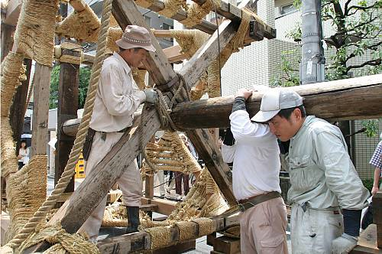
Yamahoko float ceremony: community-led activities
Community members constructing a float (c) 2007, Inoue Shigeya
Notes:
http://www.unesco.org/culture/ich/index.php?lg=en&pg=00011&RL=00269

Slide 4
Yamahoko float ceremony: community-led activities
Local residents participate
Residents’ associations responsible for different floats
Foundation for Gion Festival Preservation Associations coordinates

Slide 5
Yamahoko Float Ceremony: government support
Municipal government facilitates logistics
Provincial (prefectural) government funds and supports
National government funds and creates legislative structures,
Nominated to the RL, inscribed in 2009

Slide 6
Yamahoko Float Ceremony: other stakeholders
Local weaving and metalworking industry repair and replace necessary objects
National Research Institute and universities do research

Slide 7
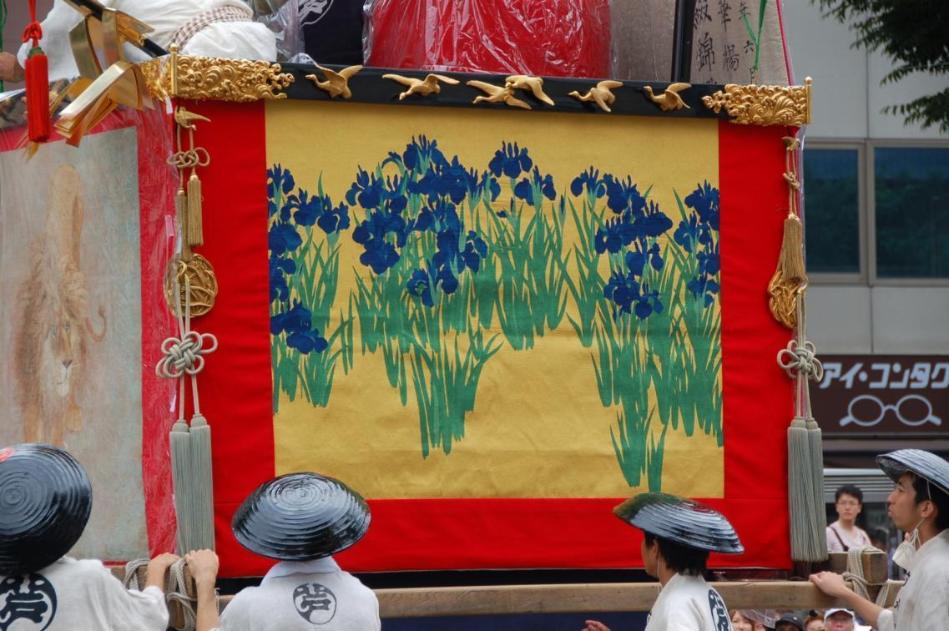
Yamahoko Float Ceremony: other stakeholders
Hangings on the floats often require repair and revitalization
Notes:
Photo © Raoul du Plessis 2009, UNESCO has permission to use

Slide 8
In this presentation…
Who are the stakeholders?
The role of States Parties
The role of communities
The role of NGOs and other stakeholders
Overview of activities

Slide 9
Who are the stakeholders?
States Parties
Communities concerned
NGOs and others, such as researchers, centres of expertise and research institutes

Slide 10
Roles of states parties

Slide 11
Roles of States Parties: national
Creating a legal & administrative context for safeguarding
Identifying, defining, inventorying,
ICH elements
Ensuring safeguarding of the ICH present in their territory
Awareness-raising

Slide 12
The Convention requires that ...
Ensure the safeguarding of the ICH in their territory (Art. 11(a))
Identify and define the ICH with the participation of communities, groups and relevant NGOs (Art. 11(b))
Draw up and update inventories of the ICH (Art. 12)
States Parties shall …

Slide 13
The Convention recommends that ...
Adopt general policy (Art. 13(a))
Establish / designate institutions for safeguarding (Art. 13(b))
Foster research (Art. 13(c))
Ensure appropriate access (Art. 13(d)(ii))
Ensure respect for ICH (Art. 14(a))
Ensure community participation (Art. 15)
States Parties may ...

Slide 14
The ODs recommend that
Establishing coordinating bodies and cooperative networks (OD 79-80, 86)
Undertaking capacity building and awareness-raising in communities (OD 81-2)
Establishing a directory of expertise (OD 83)
Facilitating community access to research (OD 85)
States Parties try to foster participation of communities and other stakeholders by or for ...

Slide 15
The ODs also recommend that ...
Adopt codes of ethics (OD 103)
Implement appropriate legal protections for communities (OD 104)
Keep the public informed about importance of, threats to ICH, actions undertaken (OD 105)
Promote good safeguarding practices (OD 106)
Support formal and non-formal education on ICH (OD 107)
In raising awareness about the importance of ICH, States Parties try to ...

Slide 16
Role of States Parties: international
Optional:
Participating in the organs of the Convention (Art. 4-5)
International cooperation and exchange (Art. 19)
Applying for international assistance (Art.23)
Submitting nomination files (Art. 16-18)
Obligatory:
Reporting to the Committee (Art. 29)

Slide 17
The ODs recommend that
Developing regional networks of communities and expertise to safeguard shared heritage (OD 86)
Sharing documentation with each other (OD 87)
Engage in regional cooperation, for instance through Category II centres (OD 88)
States Parties try to cooperate with other States Parties by ...

Slide 18
Role of communities

Slide 19
The Convention and ODs say...
Identifying and defining their ICH (art. 11(b): with NGOs)
Inventorying their ICH (OD 80)
Preparing nominations to Lists & Register (OD, 1, 2, 7)
Developing and implementing safeguarding plans for their ICH (art. 15)
Awareness-raising activities (OD 101(b))
States Parties shall involve communities, groups and individuals concerned, in ...

Slide 20
The role of communities
Communities
Groups
Individuals do …
Identification
Inventorying
Documentation
Research
Revitalization
Ensuring sustainability
Ensuring access to places and materials
Transmission through education
Transmission
Enactment of their ICH
and
Awareness-raising
with help from other agencies if needed

Slide 21
The ODs suggest
Community centres and associations (OD 108)
Networks with other communities (OD 79, 86)
Networks with experts, research centres, NGOs etc. (OD 79, 86)
Their capacities built or reinforced (OD 82)
The communities, groups and individuals concerned should have ...
… to help them safeguard their ICH

Slide 22
Role of NGOs, experts, centres of expertise and research institutes

Slide 23
Accreditation of NGOs
The General Assembly has accredited nearly 100 NGOs, in accordance with article 9 of the Convention, so they may be called upon to assist with evaluation of nominations and assistance requests

Slide 24
Accredited NGOs, 2011
Electoral Group | Number of States Parties | NGOs accredited, also from non States Parties
W. Europe and N. America | 15 | 52
Eastern Europe | 21 | 4
Latin-America and Caribbean | 25 | 9
Asia and Pacific | 21 | 26
Africa | 26 | 5
Arab states | 15 | 1

Slide 25
NGO and other organizations: roles at international level
Some specific roles reserved for accredited NGOs, and individual experts (OD 26)
All NGOs, experts and centres of expertise, research institutions can engage in international networks, cooperation and exchange and may be invited to Committee meetings, to be consulted (Article 8.4)

Slide 26
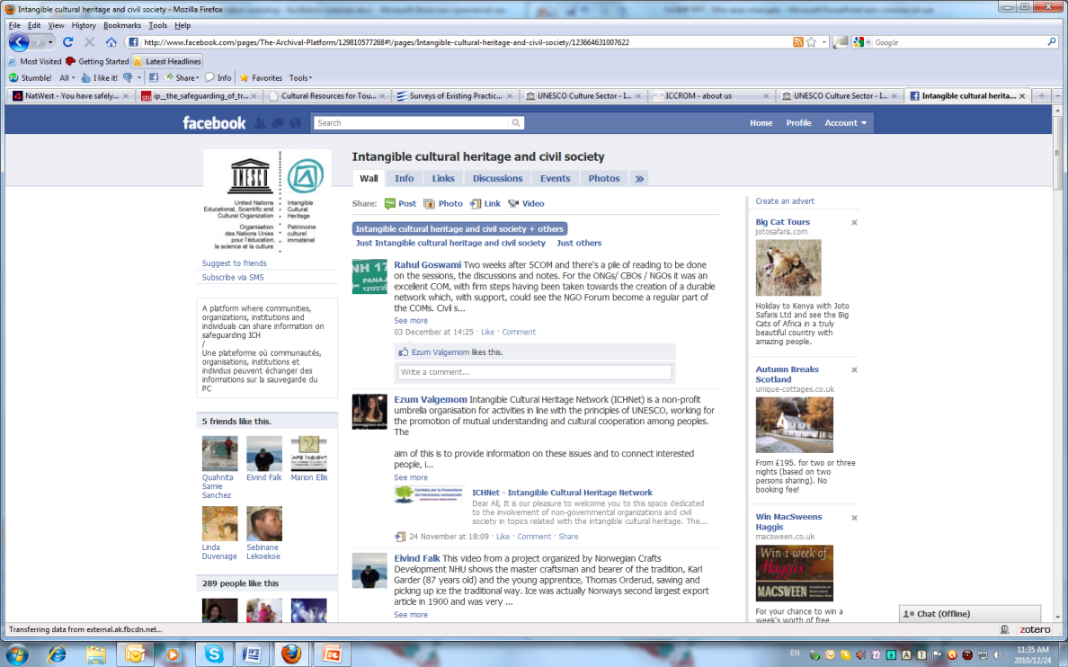
Civil Society facebook forum on ICH
http://www.facebook.com/pages/Intangible-cultural-heritage-and-civil-society/123664631007622
Notes:
http://www.facebook.com/pages/Intangible-cultural-heritage-and-civil-society/123664631007622

Slide 27
NGOs and other organizations: possible roles at national level
Raising awareness about ICH (OD 109)
Identifying and defining (OD 90)
Inventorying (OD 80)
Safeguarding (OD 90)
Research (Article 13(c), OD 83)
Preparing nomination files (OD 96(a))
Collaborations and networks (OD 79, 86)
Training in ICH management and safeguarding (OD 107)

Slide 28
multiple stakeholders, multiple activities

Slide 29
Key activities of all stakeholders
Awareness-raising
Inventorying
Community participation and consent
Practice and transmission of ICH
Contribute to sustainable development and a human rights culture
Create enabling legal and institutional environments
Foster international cooperation and assistance

